Slide 1
The Chef Server
A Hub for Configuration Data
2W
Notes:
You accomplished a lot so far. You created two cookbooks; one to setup workstations with your tools and a second cookbook that set up a web server that delivered a "Hello, world!" message with some pertinent information about your system.

Slide 2
Objectives
After completing this module, you should be able to:
Connect your local workstation (laptop) to a Chef Server
Upload cookbooks to a Chef Server
Bootstrap a node
Manage a node via a Chef Server
Notes:
In this module you will learn how to connect your local workstation to a Chef Server, upload cookbooks to a Chef Server, bootstrap a node, manage a node via a Chef Server.

Slide 3
More Web Servers?
More easily manage multiple nodes
Create a Hosted Chef Account
Upload your cookbooks to the Hosted Chef Server
Add your old workstation as a managed node
Notes:
Currently, your cookbook exists on a single machine. If you wanted to setup additional machines to act as web servers to serve additional traffic for your soon-to-be highly successful website, what steps would you need to take to setup an identical system?

Slide 4
Managing an Additional System
To manage another system, you would need to:
Provision a new node within your company or appropriate cloud provider with the appropriate access to login to administrate the system.
Install the Chef tools.
Transfer the myiis cookbook.
Run chef-client on the new node to apply the myiis cookbook's default recipe.
Notes:
As an exercise, roughly estimate the time it would take to accomplish this series of steps of preparing another node.
A new system would require us to provision a new node within your company or appropriate cloud provider with the appropriate access to login to administrate the system.
Install the Chef tools.
Transfer the myiis cookbook.
Run chef-client locally to apply the myiis cookbook's default recipe.
Instructor Note: This exercise is to show the value of using a Chef Server with regard to managing multiple systems. It can be done with the group, with individuals, or done in pairs.

Slide 5
Managing Additional Systems
Installing the Chef tools, transferring the myiis cookbook, and applying the run list is not terribly expensive.
Chef provides a one-line curl install.
You could use git to clone the repository from a common git repository.
Applying the run list.
Notes:
The cost of installing the Chef tools, transferring the myiis cookbook, and applying the run list is not terribly expensive.
Chef provides a one-line curl install for the Chef Development Kit (ChefDK).
You could use git to clone the repository from a common git repository. Another option is to archive the cookbook and then using SCP to copy over the contents. A third might be to mount a file share. There are a myriad ways to transfer the cookbooks to the new instance.
Then applying the run list requires the execution of a command on that system.

Slide 6



Managing Additional Systems
Now
Future
More complex to manage
Web Server
Your Laptop
Your Laptop
Web Servers
Notes:
So the overall time required to setup a new instance is not a massive time investment. This manual process will definitely take its toll when requirements demand you manage more than a few additional machines.
Some may think 10 minutes is not so bad. But what if there were 10 new nodes? 20 new nodes?
As the popularity of your site grows, one server will not be able to keep with all of the web requests. You will need to provision additional machines as demand increases.

Slide 7
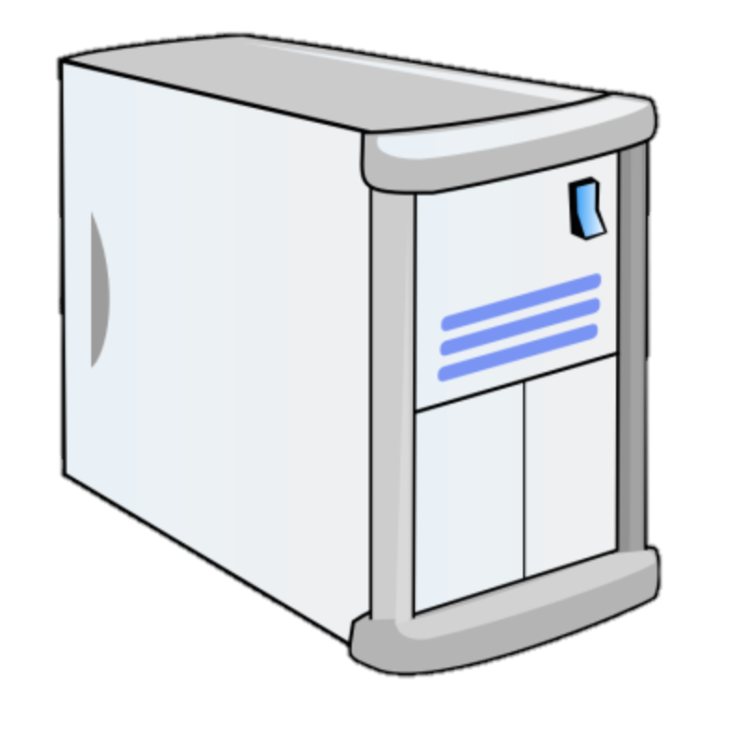
Managing User Traffic
A load balancer can forward incoming user web requests to other nodes.
Internet
Web Server
Load Balancer
Web Server
Notes:
Let's change topics for a moment to managing user web traffic.
In addition to the complexities of configuring and managing multi-server infrastructure, such as web servers, you also need to develop a way to route incoming traffic to each of those web servers and other nodes. There are many ways that you can route the traffic from one node to a group of similar nodes. This can be done with services by some of the major cloud providers or it can be done with another instance running as a load balancer. A load balancer allows us to receive incoming requests and forward those requests to other nodes. A load balancer allows us to receive incoming requests and forward those requests to other nodes.
Instructor Note: The preceding three slides covered the complexity of configuring and managing multi-server infrastructure. This slide and page is now talking about managing user web traffic, via a load balancer.

Slide 8
Managing User Traffic
Today you will set up a new load balancer that will direct web requests to similarly-configured nodes.
Internet
Web Server (web1)
Load Balancer (lb1)
Web Server (web2)
Notes:
Today you are going to set up a load balancer that will direct web requests to similar configured nodes. Those nodes will be running your default web page that you deploy with the myiis cookbook's default recipe.
In this module you are going to setup two web servers. In a later module you will create a new cookbook to define a load balancer and setup one to delivery requests to your web servers.

Slide 9
Steps to Set up Load Balancer and Web Servers
Web Server
1. Provision the instance
2. Install Chef
3. Copy the Web Server cookbook
4. Apply the cookbook
Load Balancer
Create the load balancer cookbook
Provision the instance
Install Chef
Copy the load balancer cookbook
Apply the cookbook
Notes:
Whether you tackle installing, configuring, or running a load balancer or create an instance running the myiis cookbook's default recipe, you will need to solve the problem of how you can manage multiple systems. Each system would need to have Chef installed, the cookbooks copied onto each system, and a run list of the recipes to apply to each system.
Instructor Note: The left side is setting up a new web server that is like the one they created yesterday. The right is path the learner is following today.

Slide 10
The Chef Server
An easier way to set up and maintain multiple nodes.
Cookbooks etc.
Web Server
Cookbooks etc.
Cookbooks etc.
Chef Server
Cookbooks etc.
Web Server
Local Workstation (Your laptop)
Load Balancer
Notes:
One way to solve that problem is with a Chef Server.
The Chef Server is designed to help us manage multiple nodes in this situation. The Chef Server acts as a hub for configuration data. The Chef server stores cookbooks, the policies that are applied to nodes, and metadata that describes each registered node that is being managed by 'chef-client'.
Nodes, such as web servers, load balancers, etc., use 'chef-client' to ask the Chef server for configuration details, such as recipes, templates, and file distributions. The chef-client then does as much of the configuration work as possible on the nodes themselves (and not on the Chef server). In a production environment, the 'chef-client' runs in an automated mode—it polls the Chef Server for updates at set intervals and the applies any configuration changes.
This scalable approach distributes the configuration effort throughout the organization.

Slide 11
GL: Hosted Chef
More easily manage multiple nodes
Create a Hosted Chef Account
Upload your cookbooks to the Hosted Chef Server
Add your old workstation as a managed node
Notes:
The Chef Server will make managing systems easier because it will act as a central repository for the cookbooks and other resources we need to configure multiple systems in a similar way. You can run your own Chef server but the easiest approach is to use the Hosted Chef service that we provide for free use with users that have a small node count. Perfect for the work we are doing in this module.

Slide 12
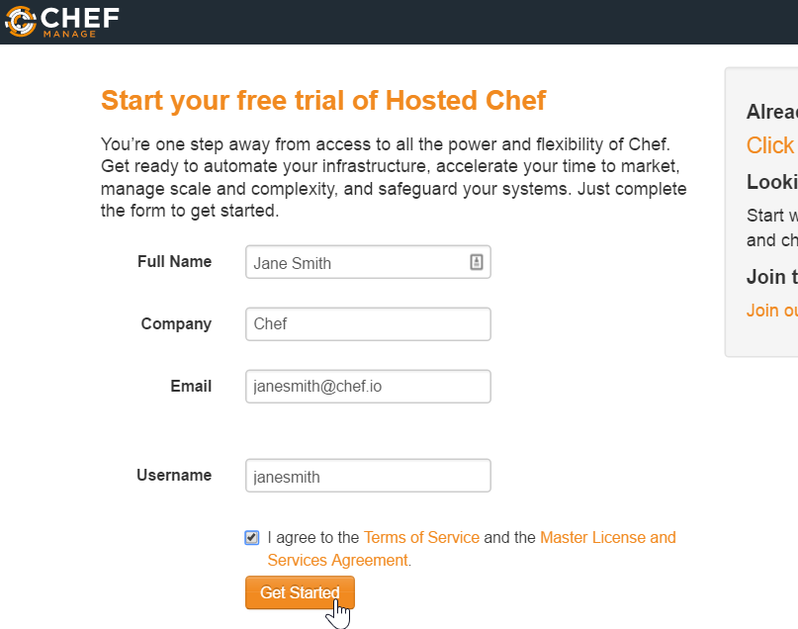
GL: Signing Up for a Hosted Chef Account
Steps
Navigate to https://manage.chef.io/signup
Fill out the form as indicated in this image using your name and a valid email address and then click Get Started.
Notes:
To get started with Hosted Chef Server, visit https://manage.chef.io/signup and sign up for a Hosted Chef Account.
Instructor Note: Learners that already have an account can login instead of creating an account. (Using the `Already have an account? Click here to sign in link`.)
The learner's account may be tied to an production organization. The learner can create a new organization with their existing account. If there are still concerns they can create a new login with a unique email address.

Slide 13
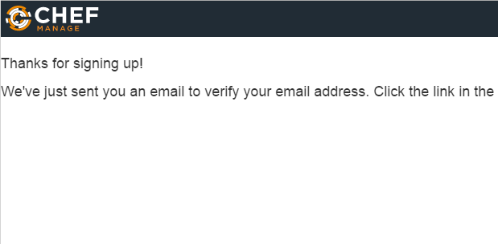
GL: Signing Up for a Hosted Chef Account
Steps
When prompted, open the email just sent to you and click the link in the email to finish the creation of your account.

Slide 14
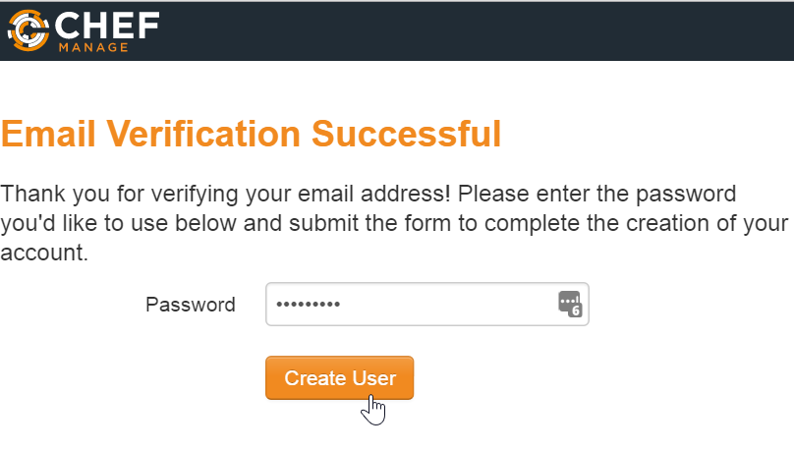
GL: Signing Up for a Hosted Chef Account
Steps
Enter a password when prompted and then click Create User. You should write down your password in case you forget it.

Slide 15
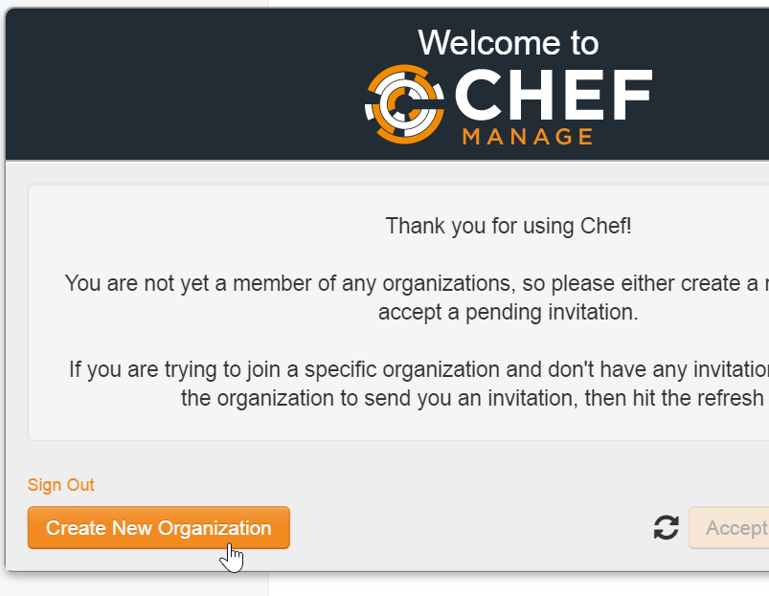
GL: Signing Up for a Hosted Chef Account
Steps
From the resulting page, click the Create New Organization button.
Notes:
Instructor Note: Learners that already have an account will already have an organization. They are welcome to use that organization if it does not have any cookbooks or nodes from previous exercises or from their production systems. It is often easier to have them create a new organization for the purposes of this training. That can be done through the website.

Slide 16
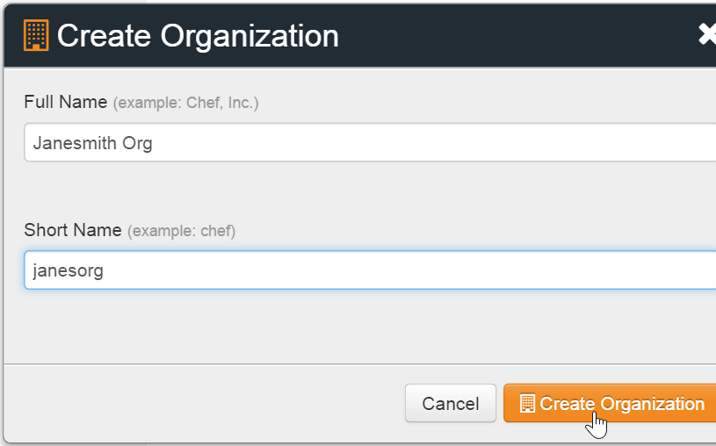
GL: Signing Up for a Hosted Chef Account
Steps
Fill out the resulting Create Organization form and then click Create Organization.
Notes:
An organization is a structure within managed Chef that allows multiple companies or entities to exist on the same Chef Server without your paths ever crossing. You might think of it as like setting up a unique username for your organization.
All of the cookbooks, instances and other configuration details that you manage with Chef will be stored on the Chef Server for this particular organization. No other organization will have access to it.

Slide 17
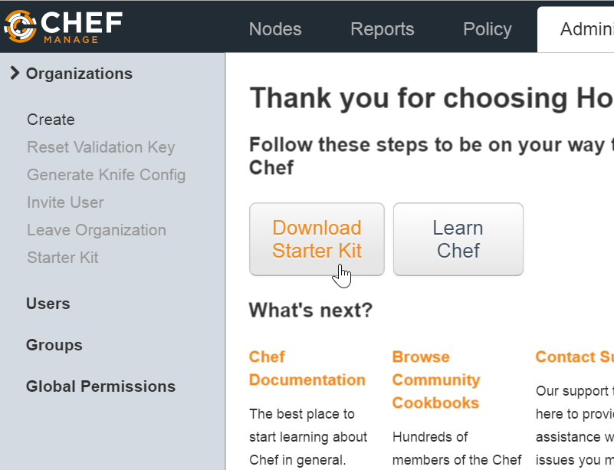
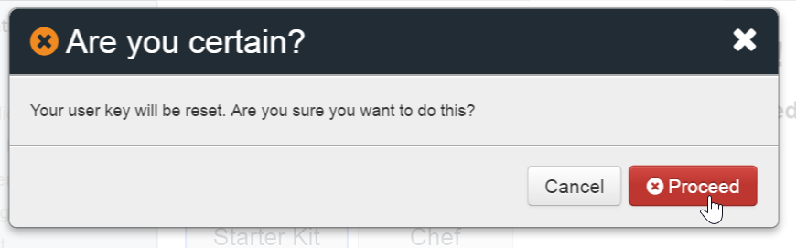
GL: Signing Up for a Hosted Chef Account
Steps
From the resulting page, click Download Starter Kit and then click Proceed when prompted.
A chef-starter zip file should download to your laptop.
Notes:
The starter kit will warn that it will reset your user key. If this is a new account and new organization, this reset is totally fine. If you already have an account or this is an existing organization please understand that you are destroying the existing keys that already exist on a workstation.
Instructor Note: By far the easiest way to get setup with Managed Chef Server is download the Starter Kit. The most important pieces of the starter kit are found in a hidden directory (".chef") which contains the organization key, user key, and organization configuration file.

Slide 18
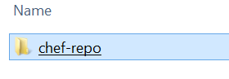
GL: Signing Up for a Hosted Chef Account
Steps
Open the downloaded zip file and copy chef-repo folder that's contained in the zip file.
Paste the chef-repo folder to a location on your laptop, such as your home directory.
Note: Ensure that the path to the chef-repo does not have a space in it. Examples:
Mac: /home/username/chef-repo
Windows: C:\Users\username\chef-repo
Notes:
Instructor Note: The reason that spaces are not suggested is that Ruby tools have a hard time with file paths that contain spaces.

Slide 19
GL: Navigate to the chef-repo
> cd ~\chef-repo
Notes:
The starter kit contains the configuration to reach the Chef Server and your credentials to validate the communication between your workstation and the Chef Server.
To verify the connection with the Chef Server you will need to run commands within the repository you downloaded.
Open a terminal or command prompt and navigate to the chef-repo directory.

Slide 20
GL: Move the cookbooks directory into the chef-repo
cd ~
mv cookbooks chef-repo

Slide 21
knife
knife is a command-line tool that provides an interface between a local chef-repo and the Chef Server.
Notes:
knife is a command-line tool that allows us to request and send information to the Chef Server.
knife helps users manage: nodes; cookbooks and recipes; roles and more.
knife provides a number of sub-commands.

Slide 22
GL: knife --help
> knife --help
Available subcommands: (for details, knife SUB-COMMAND --help)
** BOOTSTRAP COMMANDS **
knife bootstrap FQDN (options)
knife bootstrap windows ssh FQDN (options)
knife bootstrap windows winrm FQDN (options)
** CLIENT COMMANDS **
knife client bulk delete REGEX (options)
knife client create CLIENT (options)
knife client delete CLIENT (options)
knife client edit CLIENT (options)
Notes:
You can look at all the commands with 'knife –help'.
This will display all the sub-commands available. In your case you want to verify that the client list contains a single entry so you need to look for help for the specific command 'knife client --help'.

Slide 23
GL: knife client --help
> knife client --help
Available client subcommands: (for details, knife SUB-COMMAND --help)
** CLIENT COMMANDS **
knife client bulk delete REGEX (options)
knife client create CLIENT (options)
knife client delete CLIENT (options)
knife client edit CLIENT (options)
knife client list (options)
knife client reregister CLIENT (options)
knife client show CLIENT (options)
Notes:
This will give us an even smaller subset of the commands related specifically to asking the Chef Server about client information. A general command is the list command which will output all the clients that the Chef Server currently maintains.

Slide 24
GL: knife client list
> knife client list
ORGNAME-validator
Notes:
For your Chef Server account there should be a single client that is the organization name: validator. This is a special key that has access to the Chef Server. The important thing is that the result does not contain an error with the configuration or authenticating with the Chef Server.
If you receive an error ensure that you:
typed the command correctly
executed the command within the chef repository
are connected to the internet and not blocking ssl connections from your own system's proxy servers or virtual private networks
have a .chef directory, within the chef repository, which contains the knife configuration file (knife.rb), personal key, and organizational key

Slide 25
Hosted Chef
More easily manage multiple nodes
Create a Hosted Chef Account
Upload your cookbooks to the Hosted Chef Server
Add your old workstation as a managed node
Notes:
With all that complete, you are now able to communicate with the Chef Server. At this point we will refer to the system in front of you, with the chef repository, the configuration, and the keys installed as your workstation.
When working with Chef with a Chef Server, the workstation is the location where you will compose your cookbook code. When that code is complete, you will then upload it to the Chef Server.

Slide 26
GL: knife cookbook --help
> knife cookbook --help
** COOKBOOK COMMANDS **
knife cookbook bulk delete REGEX (options)
knife cookbook create COOKBOOK (options)
knife cookbook delete COOKBOOK VERSION (options)
knife cookbook download COOKBOOK [VERSION] (options)
knife cookbook list (options)
knife cookbook metadata COOKBOOK (options)
knife cookbook metadata from FILE (options)
knife cookbook show COOKBOOK [VERSION] [PART] [FILENAME] (options)
knife cookbook test [COOKBOOKS...] (options)
knife cookbook upload [COOKBOOKS...] (options)
Notes:
Similar to asking the Chef Server about the list of available clients, you can also ask for information about cookbooks. You can find all the commands related to the cookbooks subcommand by running `knife cookbook --help`.
Similar to the list of clients, you can examine a list of cookbooks.

Slide 27
GL: knife cookbook list
> knife cookbook list
Notes:
Running this command will return the cookbooks currently uploaded to the Chef Server. The empty response should come as no surprise.
You want to change that. So you are going to upload each of your cookbooks to the Chef Server.

Slide 28
GL: Change to the myiis Directory
> cd cookbooks\myiis
Notes:
To upload a cookbook to the Chef Server you need to be within the directory of the cookbook. Let us start with the myiis cookbook. Change directory into the myiis cookbook directory which is within the cookbooks directory.

Slide 29
Berkshelf
Berkshelf is a cookbook management tool that allows us to upload your cookbooks and all of its dependencies to the Chef Server.
https://docs.chef.io/berkshelf.html
Notes:
To upload the cookbook you will need to use another tool called Berkshelf.
Berkshelf is a cookbook management tool that allows us to upload your cookbooks and all of its dependencies to the Chef Server. In this instance, your current cookbooks have no dependencies, but in the future when they do, Berkshelf will assist you in ensuring those are all uploaded.

Slide 30
GL: Run berks --help
> berks --help
Commands:
berks apply ENVIRONMENT # Apply version locks from Berksfile.lock to a Chef environment
berks contingent COOKBOOK # List all cookbooks that depend on the given cookbook in your
berks cookbook NAME [PATH] # Create a skeleton for a new cookbook
berks help [COMMAND] # Describe available commands or one specific command
berks info [COOKBOOK] # Display name, author, copyright, and dependency information
berks init [PATH] # Initialize Berkshelf in the given directory
berks install # Install the cookbooks specified in the Berksfile
berks list # List cookbooks and their dependencies specified by your
berks outdated [COOKBOOKS] # List dependencies that have new versions available that
berks package [PATH] # Vendor and archive the dependencies of a Berksfile
berks search NAME # Search the remote source for cookbooks matching the partial
Notes:
Berkshelf is a command-line tool that you can ask to see available the commands.

Slide 31
GL: Run berks install
> berks install
Resolving cookbook dependencies...
Fetching 'myiis' from source at .
Fetching cookbook index from https://supermarket.chef.io...
Using myiis (0.2.1) from source at .
Notes:
Berkshelf is used on a per-cookbook basis. As dependencies are often per cookbook you'll need to change into the directory of the cookbook.
You should install any dependencies that your cookbook might have. Again, in this instance there are no dependencies external to this cookbook but Berkshelf ensures that this is the case when it runs the 'berks install' command.
You'll see that it finds the current cookbook within your current directory, it contacts the Supermarket for any external dependencies, and then ...

Slide 32
GL: See the Berksfile.lock
> dir
drwxr-xr-x 7 chef chef 4096 Aug 27 18:44 .
drwxr-xr-x 4 chef chef 4096 Aug 27 16:17 ..
drwxr-xr-x 8 chef chef 4096 Aug 27 16:07 .git
-rw-r--r-- 1 chef chef 126 Aug 27 15:46 .gitignore
drwxr-xr-x 3 chef chef 4096 Aug 27 18:45 .kitchen
-rw-r--r-- 1 chef chef 183 Aug 27 18:44 .kitchen.yml
-rw-r--r-- 1 chef chef 47 Aug 27 15:46 Berksfile
-rw------- 1 chef chef 77 Aug 27 18:45 Berksfile.lock
-rw-r--r-- 1 chef chef 54 Aug 27 15:46 README.md
-rw-r--r-- 1 chef chef 974 Aug 27 15:46 chefignore
-rw-r--r-- 1 chef chef 198 Aug 27 15:46 metadata.rb
drwxr-xr-x 2 chef chef 4096 Aug 27 16:34 recipes
Notes:
...it completes by writing a Berksfile.lock to the file system.
The Berksfile.lock is a receipt of all the cookbooks and dependencies found at the exact moment that you ran 'berks install'.

Slide 33
GL: See the Contents of the Berksfile.lock
> cat Berksfile.lock
DEPENDENCIES
myiis
path: .
metadata: true
GRAPH
myiis (0.2.1)
Notes:
This lock file is useful to ensure that in the future you use the same dependencies when working with the cookbook.

Slide 34
GL: Upload the Cookbook to the Chef Server
> berks upload
Uploaded myiis (0.2.1) to: 'https://api.chef.io:443/organizations/awesomestudent'
Notes:
With the dependencies accounted for, it is time to upload the cookbook to the Chef Server. This is another sub-command that Berkshelf provides called 'upload'. Run the command to upload the myiis cookbook to the Chef Server.

Slide 35
GL: Display Cookbooks within Your Org
> knife cookbook list
myiis 0.2.1
Notes:
When that is complete you can return to the cookbook command that allows you to display the cookbooks within your organization by running this command. This will show you that the Chef Server has the myiis cookbook that you have uploaded.

Slide 36
Lab: Upload Cookbooks
Upload your remaining cookbooks
Verify that all cookbooks are uploaded
Notes:
As a lab, upload the remaining cookbooks within the cookbooks directory. After you have done that verify that the cookbooks have been uploaded.
Instructor Note: Allow 5 minutes to complete this exercise.

Slide 37
Lab: cd and Run knife cookbook list
> cd ~\chef-repo\cookbooks\workstation
> knife cookbook list
myiis 0.2.1
Notes:
The one remaining cookbook is the workstation cookbook. Berkshelf is a cookbook management tool that examines the contents and dependencies of a single cookbook.
Change into the cookbooks directory.
Verify that the cookbook is not currently uploaded.

Slide 38
Lab: Install the Cookbook Dependencies
> berks install
Resolving cookbook dependencies...
Fetching 'workstation' from source at .
Fetching cookbook index from https://supermarket.chef.io...
Using workstation (0.1.0) from source at .
Notes:
Run "berks install" to install all the cookbook dependencies.

Slide 39
Lab: Upload the Cookbook to the Chef Server
> berks upload
Uploaded workstation (0.1.0) to: 'https://api.chef.io:443/organizations/awesomestudent'
Notes:
Run "berks upload" to upload the cookbook and all its dependencies to the Chef Server.

Slide 40
Lab: Is the workstation Cookbook Uploaded?
> knife cookbook list
myiis 0.2.1
workstation 0.1.0
Notes:
Lastly, run "knife cookbook list" to validate that the workstation cookbook is now uploaded to the Chef Server.

Slide 41
Lab: Upload Cookbooks
Upload your remaining cookbooks
Verify that all cookbooks are uploaded
Notes:
All the cookbooks have been uploaded and you have verified that fact.

Slide 42
Hosted Chef
More easily manage multiple nodes
Create a Hosted Chef Account
Upload your cookbooks to the Hosted Chef Server
Add your web server as a managed node
Notes:
You have one remaining objective and that is to add an instance as a node within your organization.

Slide 43
The Node
Organization 1 Nodes
Organization 2 Nodes
Organization 3 Nodes
Chef Server
Notes:
As you know by now, a node is a server that Chef is managing. A node could be a web server, an application server, a database server, a load balancer, and so on.
A node can only join one organization. To be a node means that it has Chef installed, has configuration files in place, and when you run the chef-client application with no parameters it will successfully contact the Chef Server and ask it for the run list that it should apply and the cookbooks required to execute that run list.
When a node is part of the organization you manage that information on the Chef Server as well. A Chef Server can manage multiple organizations. Managing that information in a Chef Server allows us to use for inventory, querying and searching.

Slide 44
GL: Change to the chef-repo
> cd ~\chef-repo
Notes:
Let's add the instance we used previously as a workstation now as a managed node. Return to the root of the chef repository.

Slide 45
GL: Run 'knife node –help'
> knife node --help
** NODE COMMANDS **
knife node bulk delete REGEX (options)
knife node create NODE (options)
knife node delete NODE (options)
knife node edit NODE (options)
knife node environment set NODE ENVIRONMENT
knife node from file FILE (options)
knife node list (options)
knife node run_list add [NODE] [ENTRY[,ENTRY]] (options)
knife node run_list remove [NODE] [ENTRY[,ENTRY]] (options)
knife node run_list set NODE ENTRIES (options)
knife node show NODE (options)
Notes:
Verify that you have no existing nodes within your organization. You can use the 'knife node –help' command to see that you can ask for the list of all nodes within your organization with the list command.

Slide 46
GL: Run 'knife node list'
> knife node list
Notes:
Run "knife node list" to see that you have no nodes currently registered with your Chef Server. At this point the results should be blank.

Slide 47
GL: Run 'knife bootstrap –help'
> knife bootstrap --help
knife bootstrap FQDN (options)
--bootstrap-curl-options OPTIONS
Add options to curl when install chef-client
--bootstrap-install-command COMMANDS
Custom command to install chef-client
--bootstrap-no-proxy [NO_PROXY_URL|NO_PROXY_IP]
Do not proxy locations for the node being bootstrapped; this option is used interna
lly by Opscode
--bootstrap-proxy PROXY_URL The proxy server for the node being bootstrapped
-t TEMPLATE, Bootstrap Chef using a built-in or custom template. Set to the full path of an erb
template or use one of the built-in templates.
Notes:
Knife provides a bootstrap subcommand that takes a number of options.
When you bootstrap an instance it is performing the following:
* Installing chef tools if they are not already installed
* Configuring Chef to communicate with the Chef Server
* Running chef-client to apply a default run list

Slide 48
GL: Bootstrap Your Node
> knife bootstrap windows winrm IP -x USER -P PWD -N web1
Creating new client for web1
Creating new node for web1
Waiting for remote response before bootstrap.34.228.41.102 .
34.228.41.102 Response received.
Remote node responded after 0.02 minutes.
Bootstrapping Chef on 34.228.41.102
34.228.41.102 Rendering "C:\Users\ADMINI~1\AppData\Local\Temp\bootstrap-4032-1505928424.bat" chunk 1
34.228.41.102 Rendering "C:\Users\ADMINI~1\AppData\Local\Temp\bootstrap-4032-1505928424.bat" chunk 2
34.228.41.102 Rendering "C:\Users\ADMINI~1\AppData\Local\Temp\bootstrap-4032-1505928424.bat" chunk 3
…
Fully Qualified Domain Name or IP
user name
password
node name
Notes:
To communicate with the remote instance you need to provide it the credentials to connect to the system. Use the user name with the '-x' flag and the password '-P' flag. Include the '--sudo' flag because you are installing software and writing configuration to directories traditionally owned by the root user. Name the node with the '-N' flag. This is optional but makes it easier for us to communicate. When we ask you to look at the details of node 1 or login to node 1, it will be easier to remember than the fully-qualified domain name.
When executing the command, the output will tell us what it installed and ran.

Slide 49
GL: Run 'knife node list' Again
> knife node list
web1
Notes:
When bootstrapping is done, you can see that your organization knows about the new node by again running the command "knife node list". You now see that you have a new node, node1, uploaded to the Chef Server.

Slide 50
GL: View More Information About Your Node
> knife node show web1
Node Name: web1
Environment: _default
FQDN: WIN-DQFQCUFHDCP.ec2.internal
IP: 34.228.41.102
Run List:
Roles:
Recipes:
Platform: windows 6.3.9600
Tags:
Notes:
You can see more information about a particular node with the command 'knife node show web1'. This will display a summary of the node information that the Chef Server stores.

Slide 51
GL: Add a Recipe to a Run List
> knife node run_list add web1 "recipe[myiis]"
web1:
run_list: recipe[myiis]
Notes:
web1 does not have a list of recipes that it applies to the system by default. You can make Chef Server tell web1 to apply a specific run-list the next time web1 runs 'chef-client'.
You can do that through the 'knife node run_list add' command. In this example, you are adding to web1's run-list the myiis cookbook's default recipe.

Slide 52
GL: Verify the New Node
> knife node show web1
Node Name: web1
Environment: _default
FQDN: WIN-DQFQCUFHDCP.ec2.internal
IP: 34.228.41.102
Run List: recipe[myiis]
Roles:
Recipes:
Platform: windows 6.3.9600
Tags:
Notes:
Verify that you bootstrapped the node.

Slide 53
GL: Converge web1
> knife winrm IP -m -x USER -P PWD "chef-client"
34.228.41.102 Starting Chef Client, version 13.4.24
34.228.41.102
34.228.41.102 [2018-08-20T17:37:02+00:00] INFO: *** Chef 13.4.24 ***
34.228.41.102 [2018-09-20T17:37:02+00:00] INFO: Platform: x64-mingw32
34.228.41.102 [2018-09-20T17:37:02+00:00] INFO: Chef-client pid: 500
34.228.41.102 [2018-09-20T17:37:02+00:00] INFO: The plugin path C:\chef\ohai\plugins does not exist. Skipping...
34.228.41.102 [2018-09-20T17:37:05+00:00] INFO: Run List is [recipe[myiis]]
34.228.41.102 [2018-09-20T17:37:05+00:00] INFO: Run List expands to [myiis]
34.228.41.102 [2018-09-20T17:37:05+00:00] INFO: Starting Chef Run for web1
…
34.228.41.102 Chef Client finished, 2/4 resources updated in 39 seconds
34.228.41.102 [2018-09-20T17:37:41+00:00] INFO: Sending resource update report (run-id: a0a2aa9a-cf6d-4b94-8e18-954f28c99428)
Notes:
Apply that run list by logging into that node and running chef-client or remotely administer the node with the 'knife winrm' command as shown here.

Slide 54
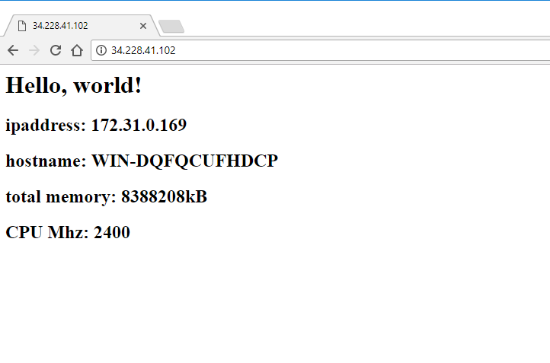
Verify web1 Serves the Page
Notes:
Verify that the node serves up the default html page that contains the node's internal IP address and hostname.

Slide 55
Setting run_list at Bootstrap
Alternatively we could have set the run_list during the bootstrap process by adding -r "recipe[myiis]".
knife bootstrap windows winrm IP -x USER -P PWD -N web1 -r "recipe[myiis]"

Slide 56
Lab: Another Web Node
Bootstrap a new node, setting the run list of the to include the web server cookbook using the `-r` flag
Verify that the node's web server is functional
Notes:
Now it's time to create a second node. This node will be the second web server node.
We will provide you with a new node for the following exercise.
Instructor Note: Allow 10 minutes to complete this exercise

Slide 57
Lab: Bootstrap the New Node
> knife bootstrap windows winrm IP_OF_web2 -x USER -P PWD -N web2 -r "recipe[myiis]"
Creating new client for web2
Creating new node for web2
Waiting for remote response before bootstrap.54.146.147.44 .
54.146.147.44 Response received.
Remote node responded after 0.02 minutes.
Bootstrapping Chef on 54.146.147.44
…
54.146.147.44 Running handlers complete
54.146.147.44 [2018-09-20T18:06:10+00:00] INFO: Report handlers complete
54.146.147.44 Chef Client finished, 2/4 resources updated in 01 minutes 02 seconds
Notes:
Bootstrap the new node and name it web2.

Slide 58
Lab: Verify the New Node
> knife node show web2
Node Name: web2
Environment: _default
FQDN: WIN-DQFQCUFHDCP.ec2.internal
IP: 54.146.147.44
Run List: recipe[myiis]
Roles:
Recipes: myiis, myiis::default, myiis::server
Platform: windows 6.3.9600
Tags:
Notes:
Verify that you bootstrapped the node.

Slide 59
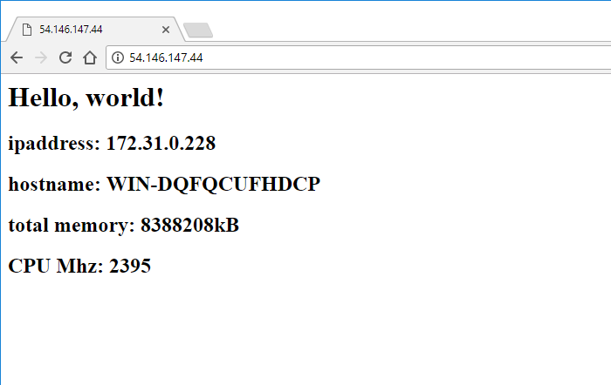
Verify that the New Node Serves the Page
Notes:
Verify that the node serves up the default html page that contains the node's internal IP address and hostname.

Slide 60
Discussion
What is the benefit of storing cookbooks in a central repository?
What is the primary tool for communicating with the Chef Server?
How did you add a node to your organization?
Notes:
Answer these questions.
With your answers, turn to another person and alternate asking each other asking these questions and sharing your answers.

Slide 61
Q&A
What questions can you help you answer?
Chef Server
Managed Chef
Berkshelf
Bootstrapping Nodes
Notes:
With all of the objectives complete you are finished with this section. What question can you answer for you?

